Slide 1
Scala Overview

Slide 2
Reminder: Scala Install
Install Scala plugin for IntelliJ
Warning: there are multiple project types for Scala
USE the IDEA since that is the most similar to what we have been using all semester
Granted, the SBT provides way more options and better integration option…but it is “finnicky” with additional libraries

Slide 3
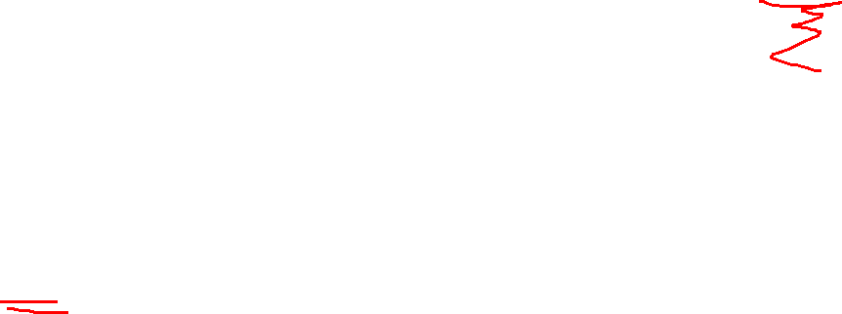
Reminder: Scala Install
Be absolutely sure you using Scala 3.X!
Fundamentally, the change to Scala 3 changed IO, so code is usually not cross platform with Scala 2!

Slide 4
Scala overview

Slide 5

Why Scala?
Requirements for this last language
Functional paradigm
Works well on Windows, Linux, and Macs
Wanted a rather unfamiliar language
But still on the Stack Overflow list!
You almost got R or F#

Slide 6

Scala History
Designed by Martin Odersky
Only around a decade old
An aside on language stability
It normally takes ~10-15 years for a language/architecture/OS to become mature and stable after the first stable release…
That assumes a decent user base
There are exceptions…XML is still in version 1.0
This means Scala is still cutting edge…
Just not BLEEDING edge

Slide 7
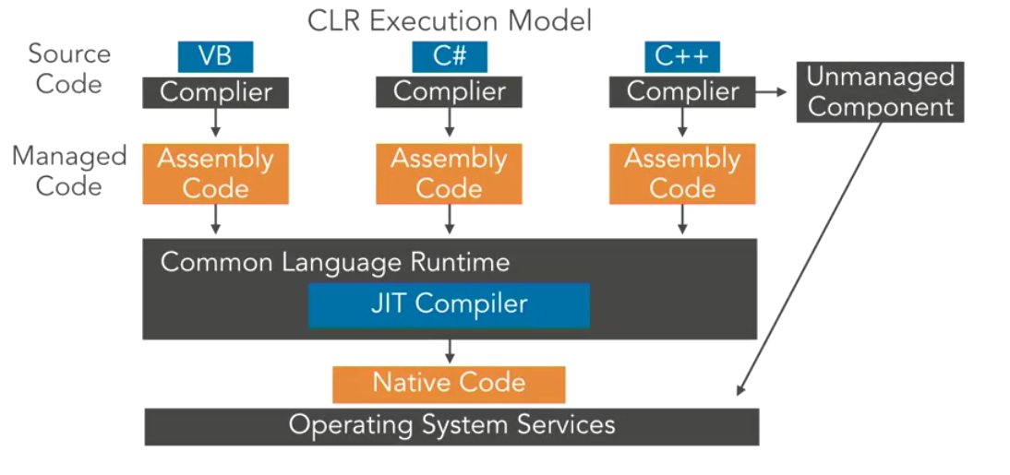
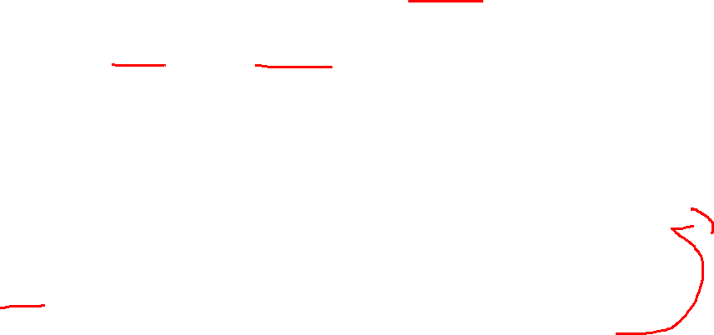
Scala overview
Scala runs on JVM!?
Yep, Scala and Java are closely related
Kotlin is based on Scala’s syntax!
C# does something like this as well with managed code and C for speed

Slide 8


Scala “Categorization”
Generation: high level
Paradigm: functional
Location:
Big Data
High small message throughput
Highly Concurrent applications
Twitter!

Slide 9
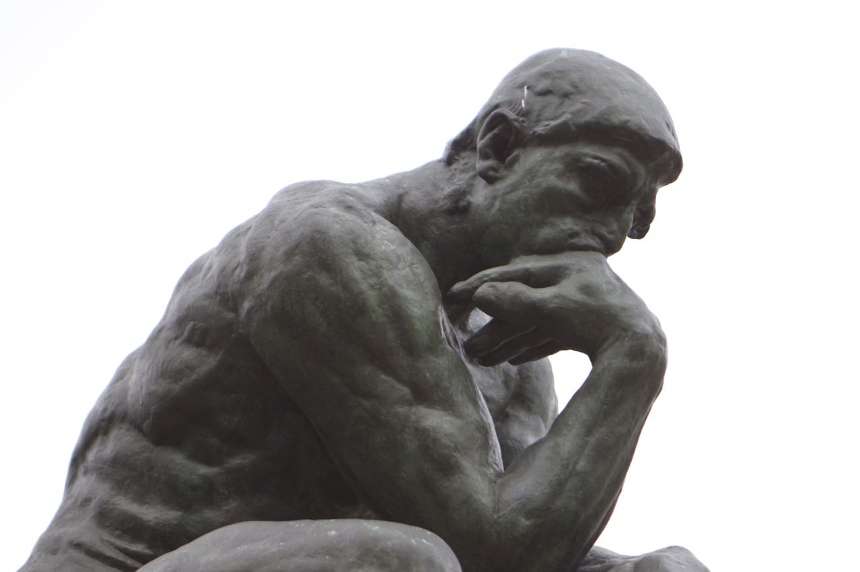
Scala Philosophy
Scala is actually short for Scalable Language
Extensibility is considered critical
Encourages no-side effects
Encourages immutable data

Slide 10
Scala Philosophy
And more!
Allow functions to be used interchangeably
Do NOT rewrite Java code!
Flexible Objects
Write once, run anywhere (same limitations as Java)

Slide 11
Scala Philosophy (start here)
Meant for experienced programming
Python→teaching lanauge
Java→fix problems with C++
SCALA→ let programmer do what they want
The return of “It is awesome you can do this, but if you actually do it…”
Wat?

Slide 12
QUESTION
Scala is built for concurrency. Why are “no side effects” helpful for this?

Slide 13
Answer
The data is more atomic, as now you only update on a return.

Slide 14
Scala Strengths and weakness
Basically, you can use Java or Scala (whichever is best for your tasks), in the SAME project…no UDC, server, RPC, etc. here!
Example: see FromJavaExample.scala
This also means this shares many of the strengths and weakness of Java

Slide 15

Scala Strengths
Many built in libraries
Better built for recursion
Incredibly easy concurrency support
Seriously…it’s 2 lines (after modules are imported)!
Reusable, and interchangeable functions is a primary concern

Slide 16

Scala Weaknesses
Slower than true compiled languages
Can reverse compilation
Security issues

Slide 17
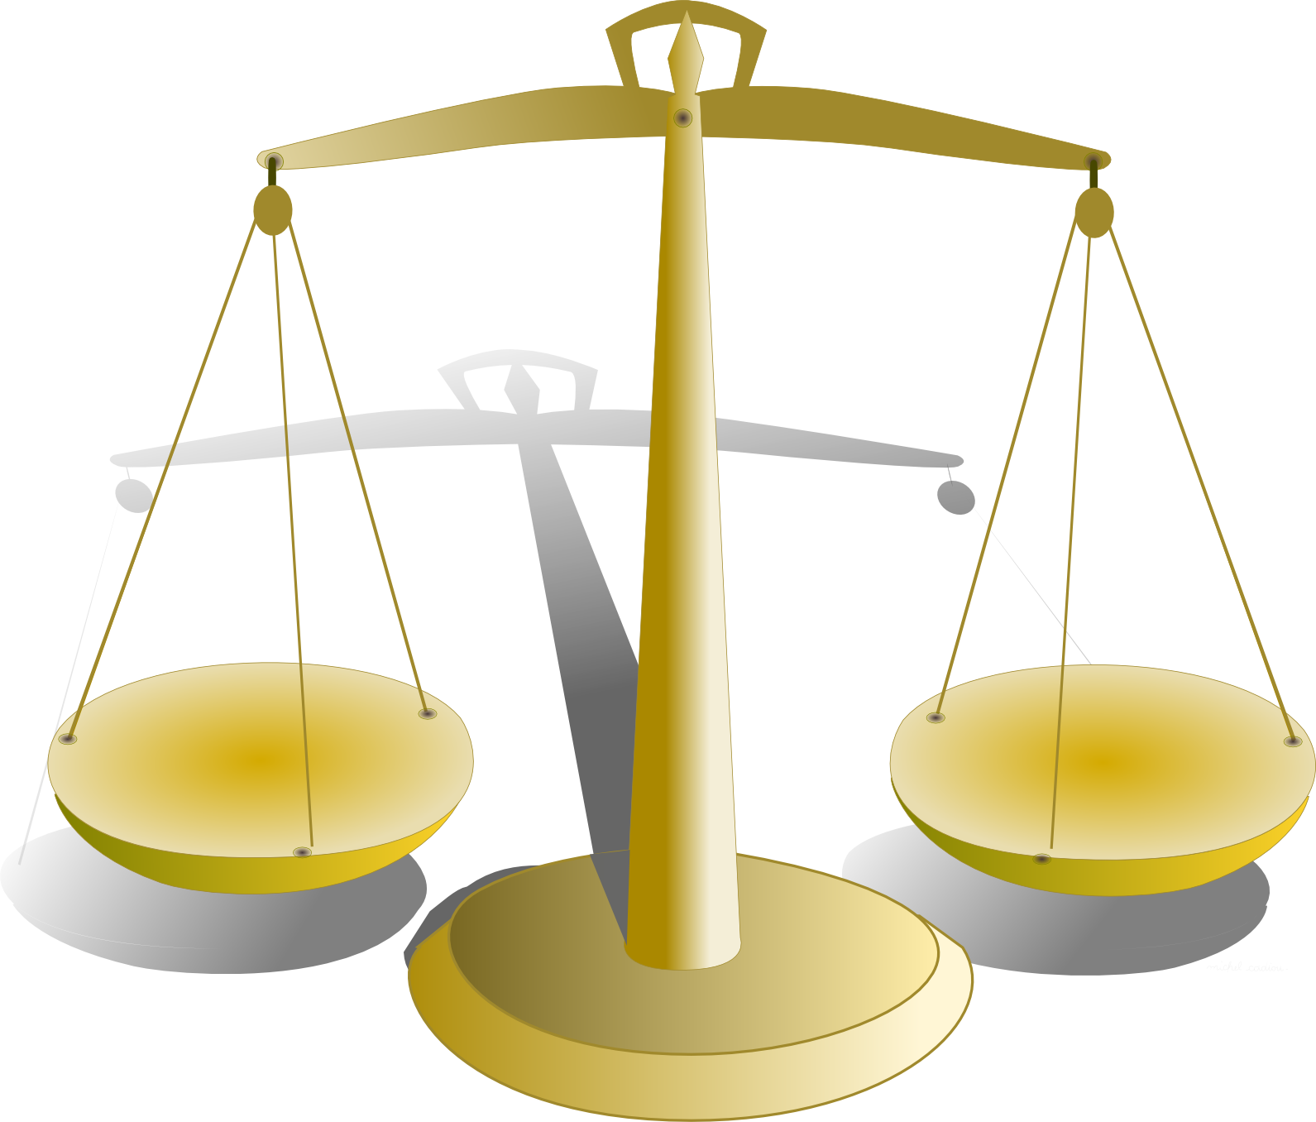
Scala “it depends”
Functional programming feels WEIRD when you first start
Immutable data is preferred
Aka prefers pure functions (aka, no side effects, and no mutations)
Substantial type inference typing:
Regularly do not name the type, but the type is static!
Garbage collection
The language handles clean dynamic memory allocations for you (Yay)
Tends to hit at the worst time (Boo)

Slide 18
Application

Slide 19

How Scala works
Scala interpreter: TWO options here
Add a Scala Worksheet
Scala Console

Slide 20
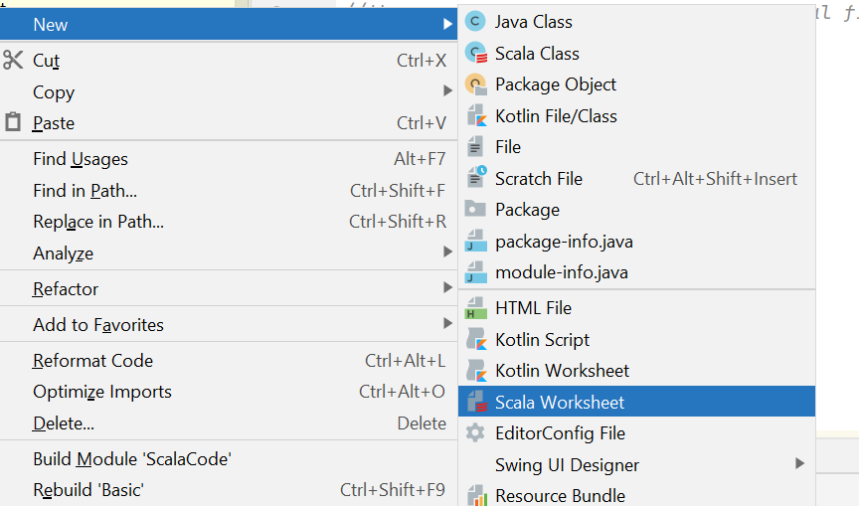
Scala Worksheet
Should be used for “scratch” purposes
List the evaluation at each step with “evaluation worksheet”
Ends file name with .sc

Slide 21
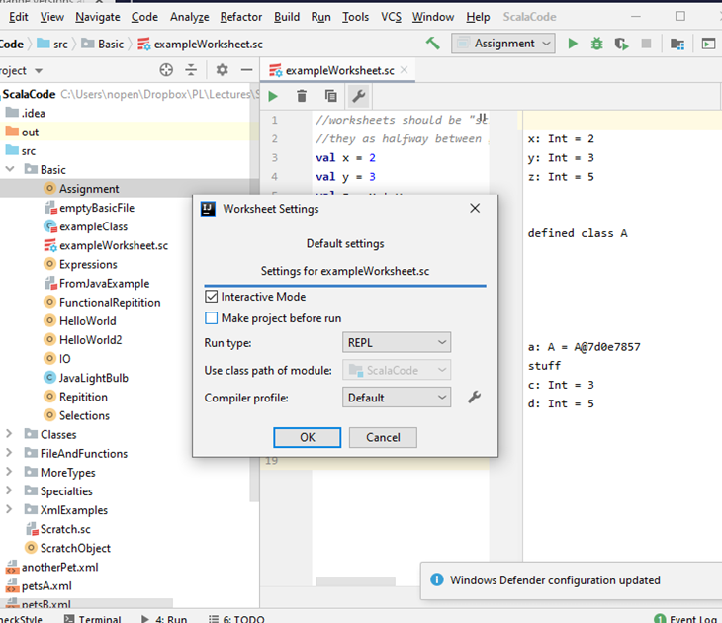
Scala worksheet
Add a Scala Worksheet
Choose “interactive mode,” (the wrench, and a title line checkbox is older versions)
Better option
REPL adds a time delay between lines

Slide 22
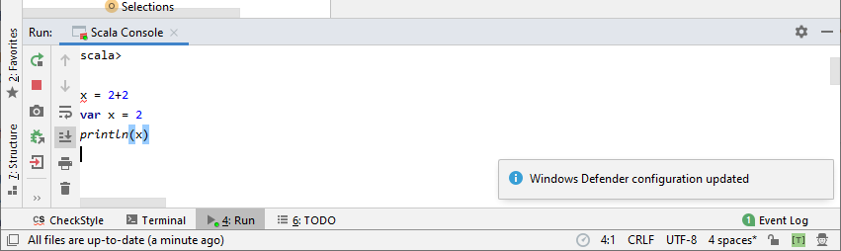
Scala Console
Also, should be used for “scratch” purposes
Open with right click on a file →scala console/Scala REPL
Type in expressions, ending in enter

Slide 23
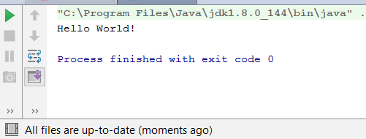
Scala file
>>>>>HelloWorld.scala
Ends files name with .scala
To make one
New →Scala class
object HelloWorld{ def main(args: Array[String]): Unit = { println("Hello World, again!") } }
Same right click and then Run as Java in IntelliJ

Slide 24
Scala Program Execution
Explanation of key words
def
Keyword to define a function (like python)
args
Our argc array
Scala follows UML style variable
Unit
Make this a “void” function declarations
Object
Contents are static
More on Object versus class, later.

Slide 25
Scala file
>>>>HelloWorld2.scala
object X extends App
Is short hand for a full class with main. E.g.
Contents:
object HelloWorld extends App{ println("Hello World!") }
Overly simplified…App “premakes” our main so we can get right to coding
I won’t care which of the first two method syou use
Side note: new →”Scala class” is just template support for classes

Slide 26
Scala file
>>>>HelloWorld3.scala
The newest versions of Scala let you choose ANY function sa the entry.
Out of scope for this class, but the most basic
Just add @main
As long as the parameters are “primitives” you are good to go

Slide 27

Scala main versus extend App
A bit more on this now:
App versus main()
App is a “trait” (interface) in Scala, and encapsulates main
Neat trick in IntelliJ:
In Windows: press and hold the CTRL key + left click on the object click (or click on the object and then ctrl+b)

Slide 28
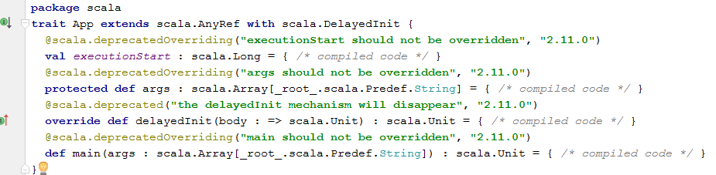
App
Decompiled code revels several of the items we would expect in main()
E.g. args, main
Also note that many of the functions have restrictions on them

Slide 29

Structure notes
Like Java the file name and object/class MUST match (well OK, it will compile with a warning)
The package name is the list of folders separated by a .
You MUST use a unique package name when submitting

Slide 30


Modules
To add outside libraries is similar to Java, with different partial import syntax
To import ALL
import name.name.lastGroup._
.* become ._
OR, if you only want part
import name.name.lastGroup.{item1, item2, …}
IO important one
import scala.io.StdIn

